Slide 1
MongoDB indexing, monitoring, and backup
Jiapeng Zhang, Tianwei Li
Nov. 7, 2018

Slide 2
Indexing
A database index is a data structure that improves the speed of data retrieval operations on a database table at the cost of additional writes and storage space to maintain the index data structure.

Slide 3
Indexing in MongoDB
Support efficient execution of queries in MongoDB
Special data structures(B-Tree) storing a small portion of the data set , easy to traverse
Ordering of the index entries supports: efficient equality matches and range-based query operations

Slide 4
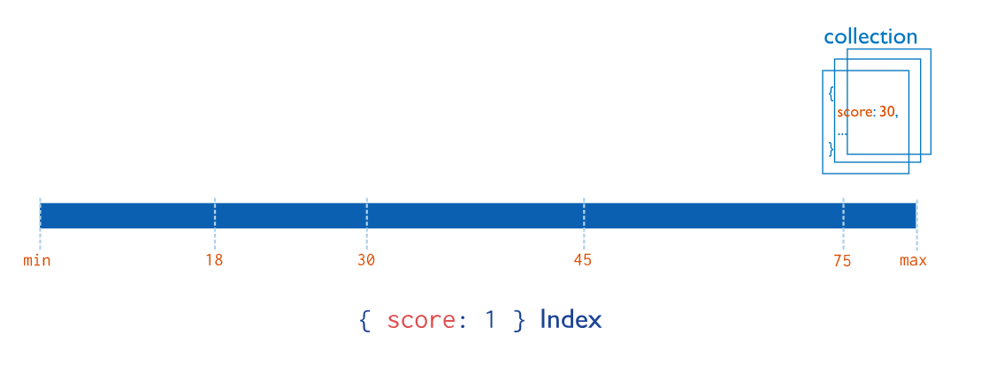
Index Types
Single Field: _id index

Slide 5
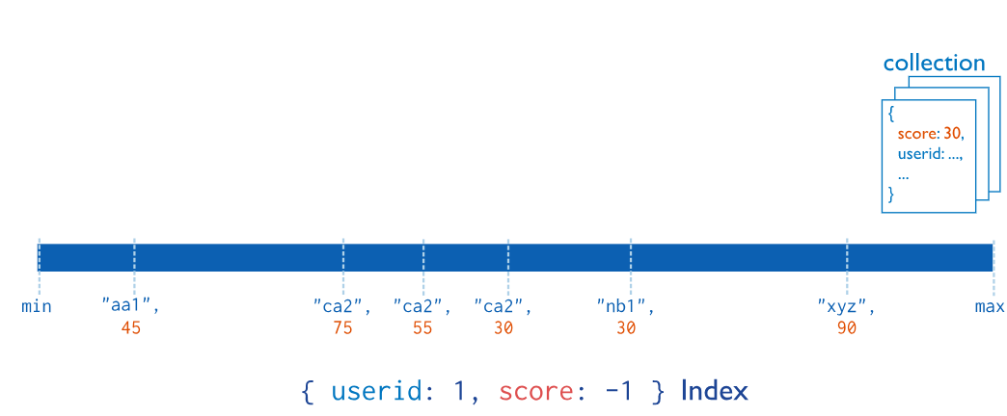
Index Types
Compound Field: multiple fields

Slide 6
Index Types
Multikey Index: index the content stored in arrays, automatically
Geospatial Index: special 2d indexes
Text Indexes: only root words
Hashed Indexes: index the hash of the value of a field

Slide 7
Index Types
Partial Indexes: only index those meeting a condition
TTL Indexes: automatically remove documents for some time

Slide 8
Create an index
db.collection.createIndex( <key and index type specification>, <options> )
<key and index type specification>: a document that contains the field and value pairs where the field is the index key and the value describes the type of index for that field. For an ascending index on a field, specify a value of 1; for descending index, specify a value of -1.
<options>: optional settings

Slide 9
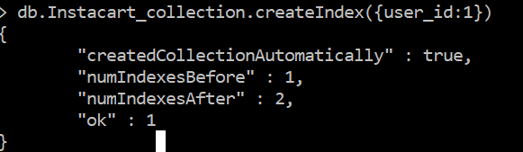
Create an index: examples
Single Field:
db.Instacart_collection.createIndex({user_id:1})

Slide 10
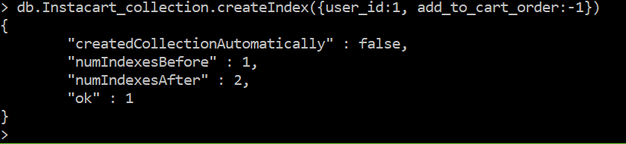
Create an index: examples
Compound Field:
db.Instacart_collection.createIndex({user_id:1, add_to_cart_order:-1})

Slide 11
Monitoring
A firm grasp of MongoDB’s reporting will allow you to assess the state of your database and maintain your deployment without crisis.

Slide 12
Free monitoring
Free cloud monitoring for standalones or replica sets
Enable/disable free monitoring during runtime using db.enableFreeMonitoring() and db.disableFreeMonitoring()

Slide 13
Utilities
mongostat
captures and returns the counts of database operations by type (e.g. insert, query, update, delete, etc.).
mongotop
tracks and reports the current read and write activity of a MongoDB instance, and reports these statistics on a per collection basis.

Slide 14
Commands
db.serverStatus()
returns a general overview of the status of the database, detailing disk usage, memory use, connection, journaling, and index access.
db.stats()
reflect the amount of storage used, the quantity of data contained in the database, and object, collection, and index counters.
db.collection.stats()
provides statistics on the collection level
rs.status()
returns an overview of replica set’s status

Slide 15
Backup
When deploying MongoDB in production, you should have a strategy for capturing and restoring backups in the case of data loss events.

Slide 16
Back Up with Atlas
Official MongoDB cloud service
2 fully-managed methods:
Continuous backups:
take incremental backups of data in your cluster, ensuring your backups are typically just a few seconds behind the operational system
Cloud provider snapshots:
provide localized backup storage using the native snapshot functionality of the cluster’s cloud service provider

Slide 17
Back Up with MongoDB Cloud Manager or Ops Manager
MongoDB cloud manager:
continually backs up MongoDB replica sets and sharded clusters
creates snapshots of your data at set intervals
offer point-in-time recovery of MongoDB replica sets and sharded clusters.
Ops manager:
an on-premise solution that has similar functionality to MongoDB Cloud Manager

Slide 18
Back Up by Copying Underlying Data Files
Back Up with Filesystem Snapshots:
supports point-in-time snapshots
Back Up with cp or rsync:
not support snapshots

Slide 19
Back Up with mongodump
Creates high fidelity BSON files
Backing up and restoring small MongoDB deployments

